Slide 1
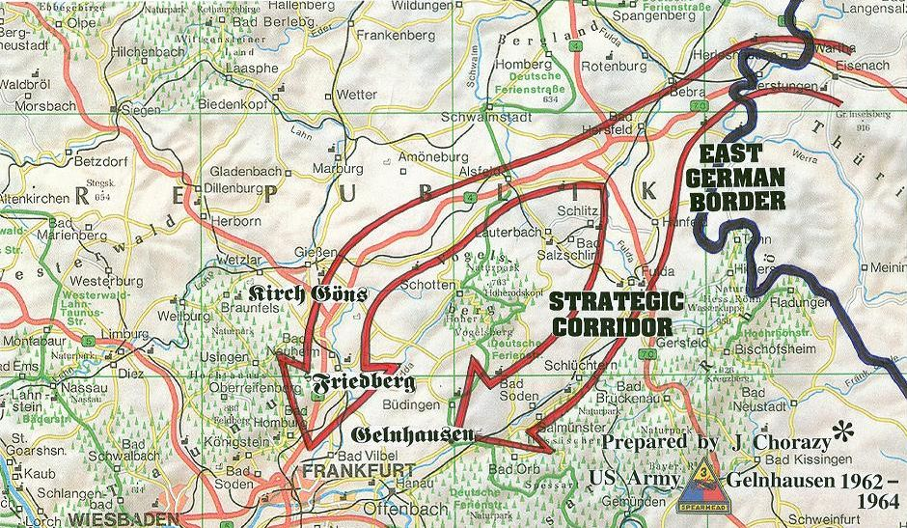
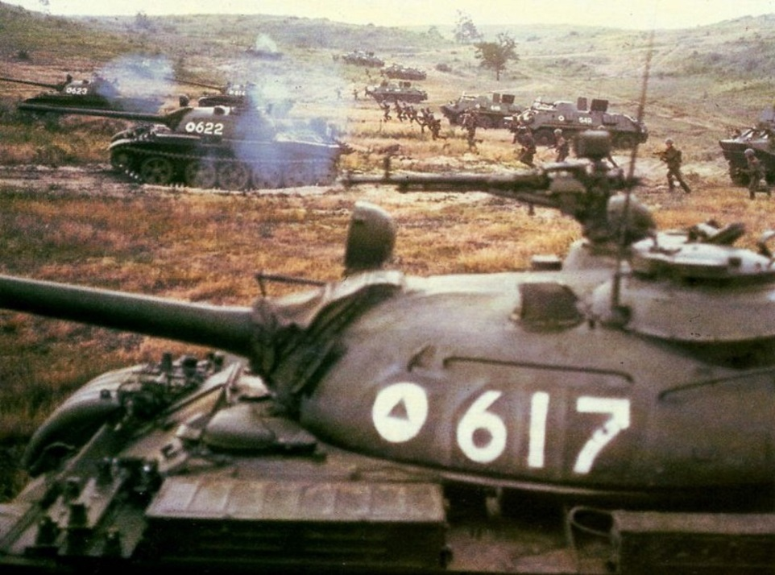
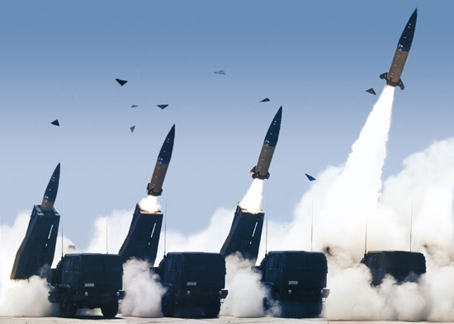
FSCORD – Battle for Fulda Gap
FSCORD – Battle for Fulda Gap @ 2015, All rights reserved to Shmuel Shmuel

Slide 2
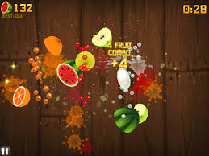
Concept
Single player, fast paced arcade for tablets, with elements of MOBA and RPG.
A combination of this:
And this (min. 25-31):
https://www.youtube.com/watch?v=zlvodY3o65U

Slide 3
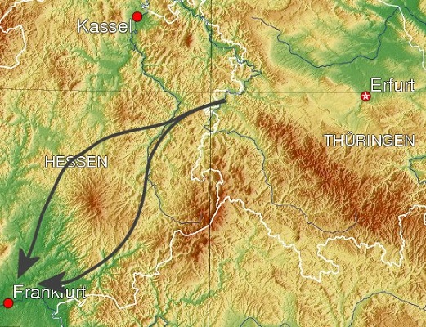
Plot
It is 1983. The Cold war is at its peak. One Sunday morning, the sirens begin. You are a Fire Support Coordination Officer (FSCORD) in the 1st Squadron, 11th Cavalry Regiment, US Army, station in the Fulda Gap. You and your tank troop are the only force between the enemy and Frankfurt. The Soviets are coming.

Slide 4
Controls
Touch interface and gestures: Taping on the screen employs artillery in the game.
One tap: one High Explosive (HE) shell.
Circle gestures and tapping inside: concentrated artillery strike (with slow motion).
Swipe: Napalm strike.
X: Daisy cutter.
Press & Drag: Scaterable mines.
Press and Shake Device: Tactical Nuke.
Two finger swipe: Move camera.
Press and Rotate: Pan camera
Spread/Pinch: Zoom in/out

Slide 5
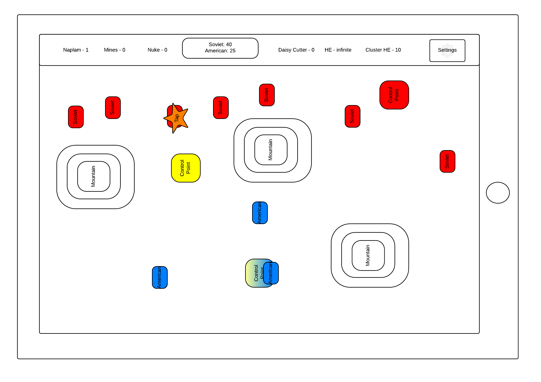
High Explosive

Slide 6
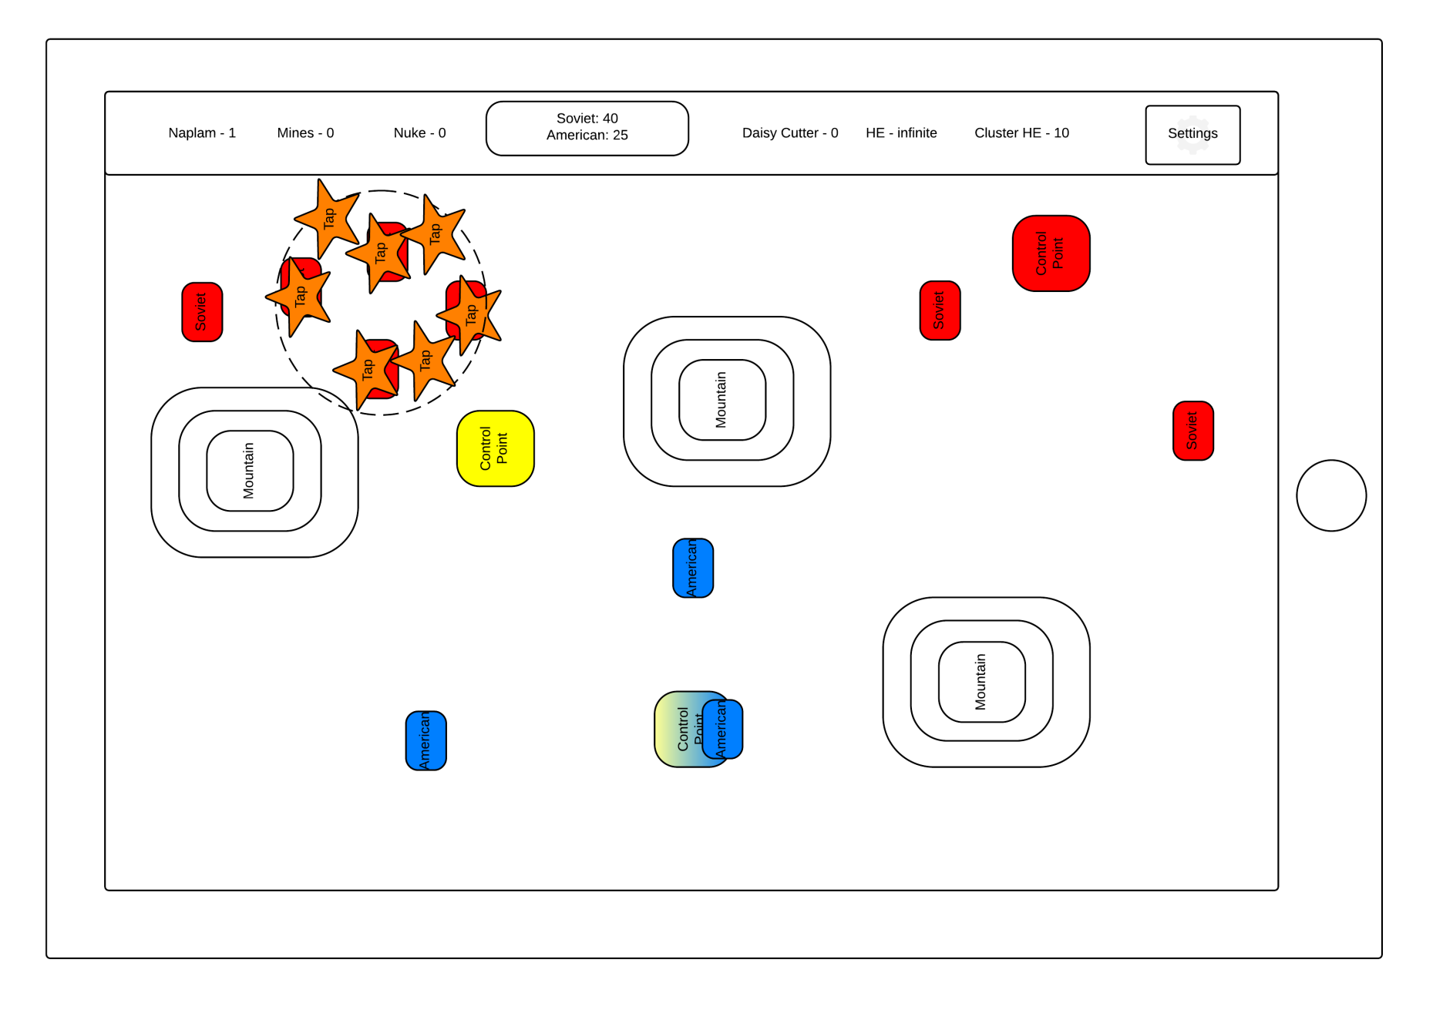
Cluster High Explosive

Slide 7
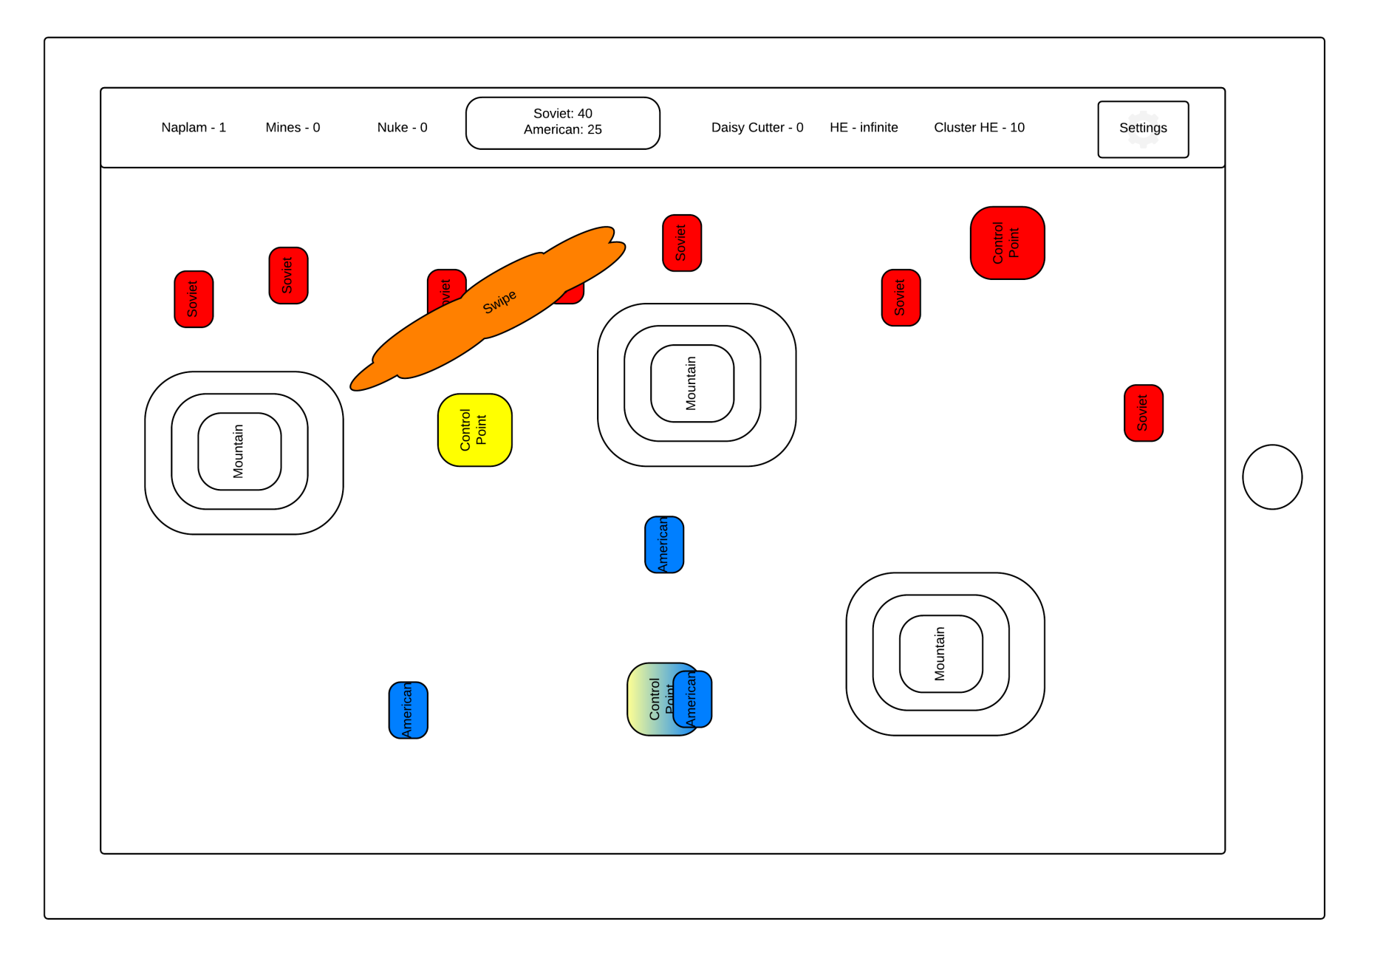
Napalm Strike

Slide 8
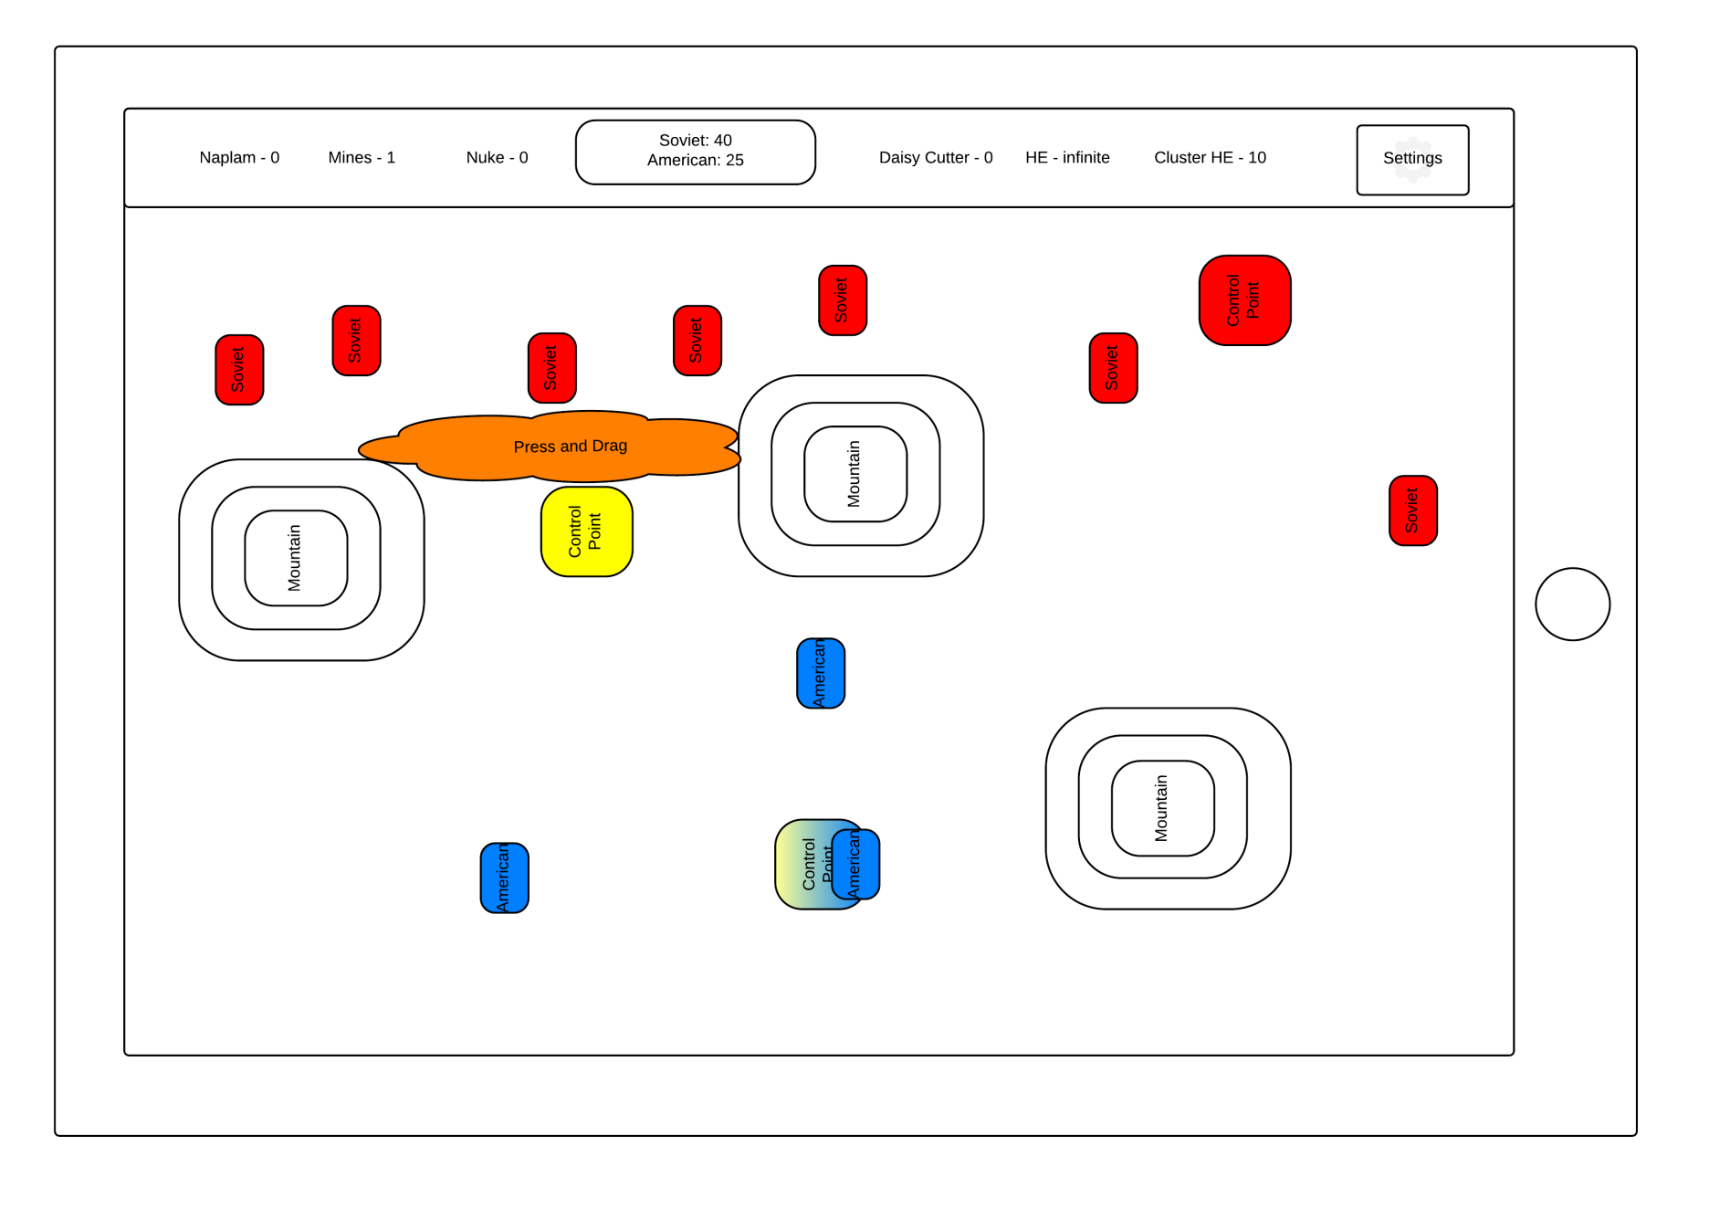
Scatrable Mines

Slide 9
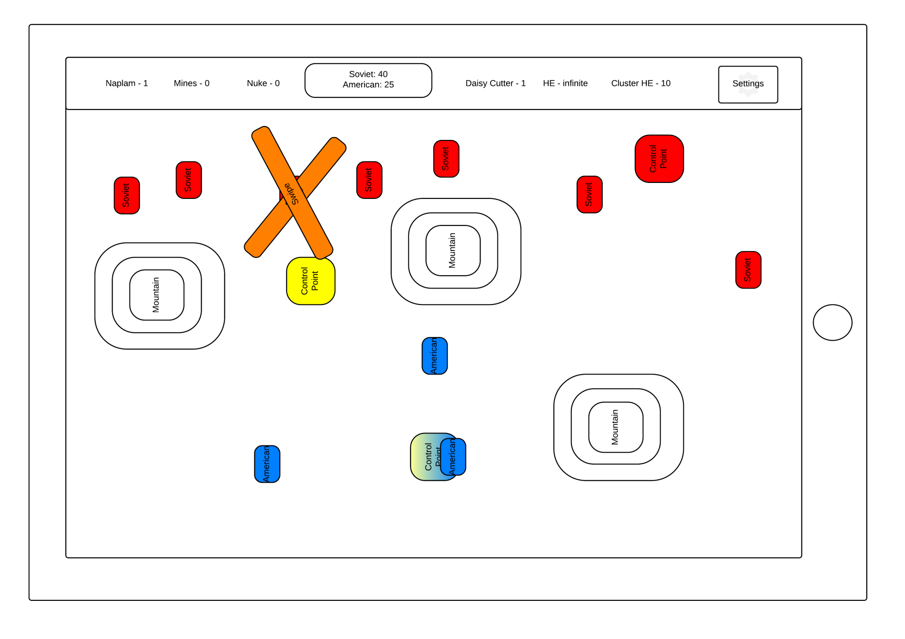
Daisy Cutter

Slide 10
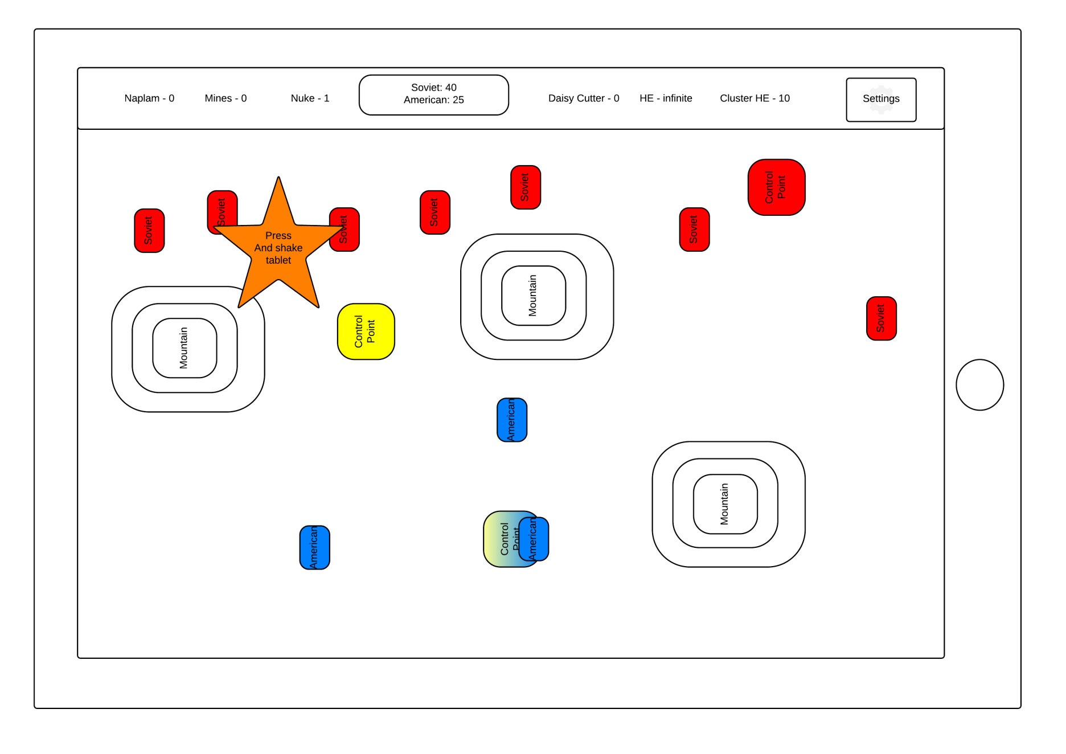
Tactical Nuke

Slide 11
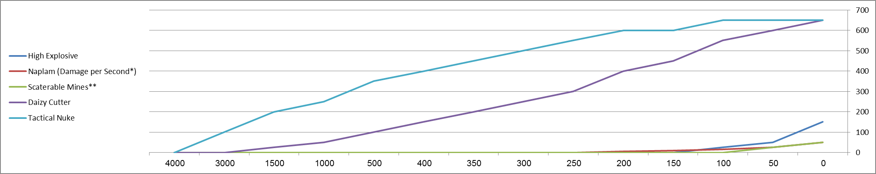
Artillery Damage
 |  |  |  |  |  | Diameter of Effect (Meters)
Ammunition Type/Damage | 0 | 50 | 100 | 150 | 200 | 250 | 300 | 350 | 400 | 500 | 1000 | 1500 | 3000 | 4000
High Explosive | 150 | 50 | 25 | 0 | 0 | 0 | 0 | 0 | 0 | 0 | 0 | 0 | 0 | 0
Naplam (Damage per Second*) | 50 | 25 | 15 | 10 | 5 | 0 | 0 | 0 | 0 | 0 | 0 | 0 | 0 | 0
Scaterable Mines** | 50 | 25 | 0 | 0 | 0 | 0 | 0 | 0 | 0 | 0 | 0 | 0 | 0 | 0
Daizy Cutter | 650 | 600 | 550 | 450 | 400 | 300 | 250 | 200 | 150 | 100 | 50 | 25 | 0 | 0
Tactical Nuke | 650 | 650 | 650 | 600 | 600 | 550 | 500 | 450 | 400 | 350 | 250 | 200 | 100 | 0
*Naplam will cause damage for 10 seconds
**scatrable mine will stop an effected tank for 5 seconds

Slide 12
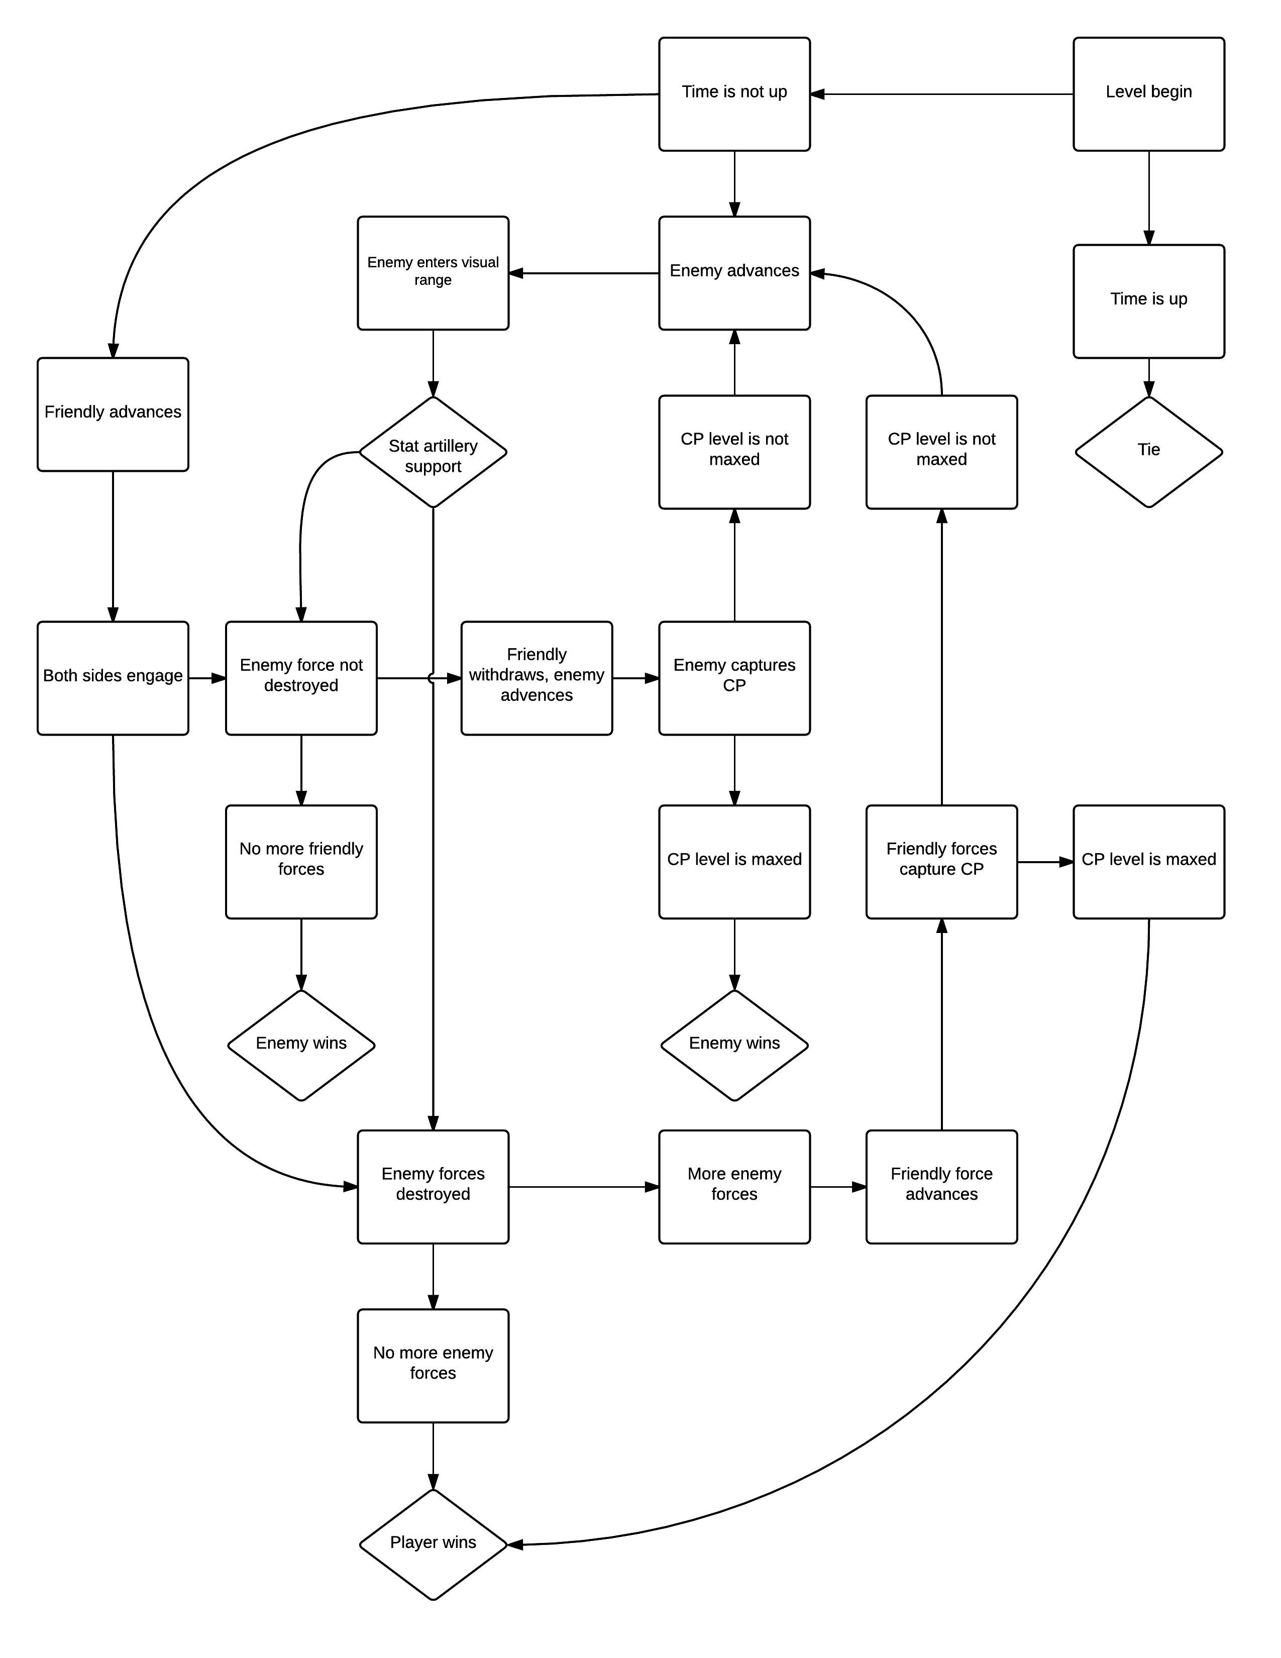
Gameplay
Details

Slide 13
Gameplay Details
In the beginning of the game, American tanks start at one area of the map.
American tanks automatically move towards Control Points on the screen.
Soviet tanks instantiate in waves on a certain area in the map and move towards the same Control Points.
The majority of the screen will be covered with fog of war.
Some levels will contain American listening posts which will reveal a certain area of the screen, allowing artillery interdiction.
American tanks will reveal a certain area of the screen around them, allowing for artillery engagement of Soviet forces.
When both forces meet, they engage.
American forces enter position and leave them only after the wave ends.
Generally, Soviets will enjoy (vast) numerical superiority in tanks over the American forces.
Player needs to employ artillery to destroy Soviet forces and support his tanks. There are several types of artillery munitions:
All munitions will be given to the player randomly after destroying Soviet vehicles.
Ammunition will be kept between levels.
There are 2 types of maps:
Capture the Flag:
Upon reaching a Control Point and clearing it, tanks will start to capture it.
Every few seconds, each captured Control Point adds a certain amount to the Control Score.
The side that reaches the Score Goal wins.
Alternately, the side that runs out of tanks first, loose.
Reach the End of the Screen:
Each side needs to bring his forces to the opposite side's base (spawn point).
The side that reaches that point first, wins.
Alternately, the side that runs out of tanks first, loose.

Slide 14
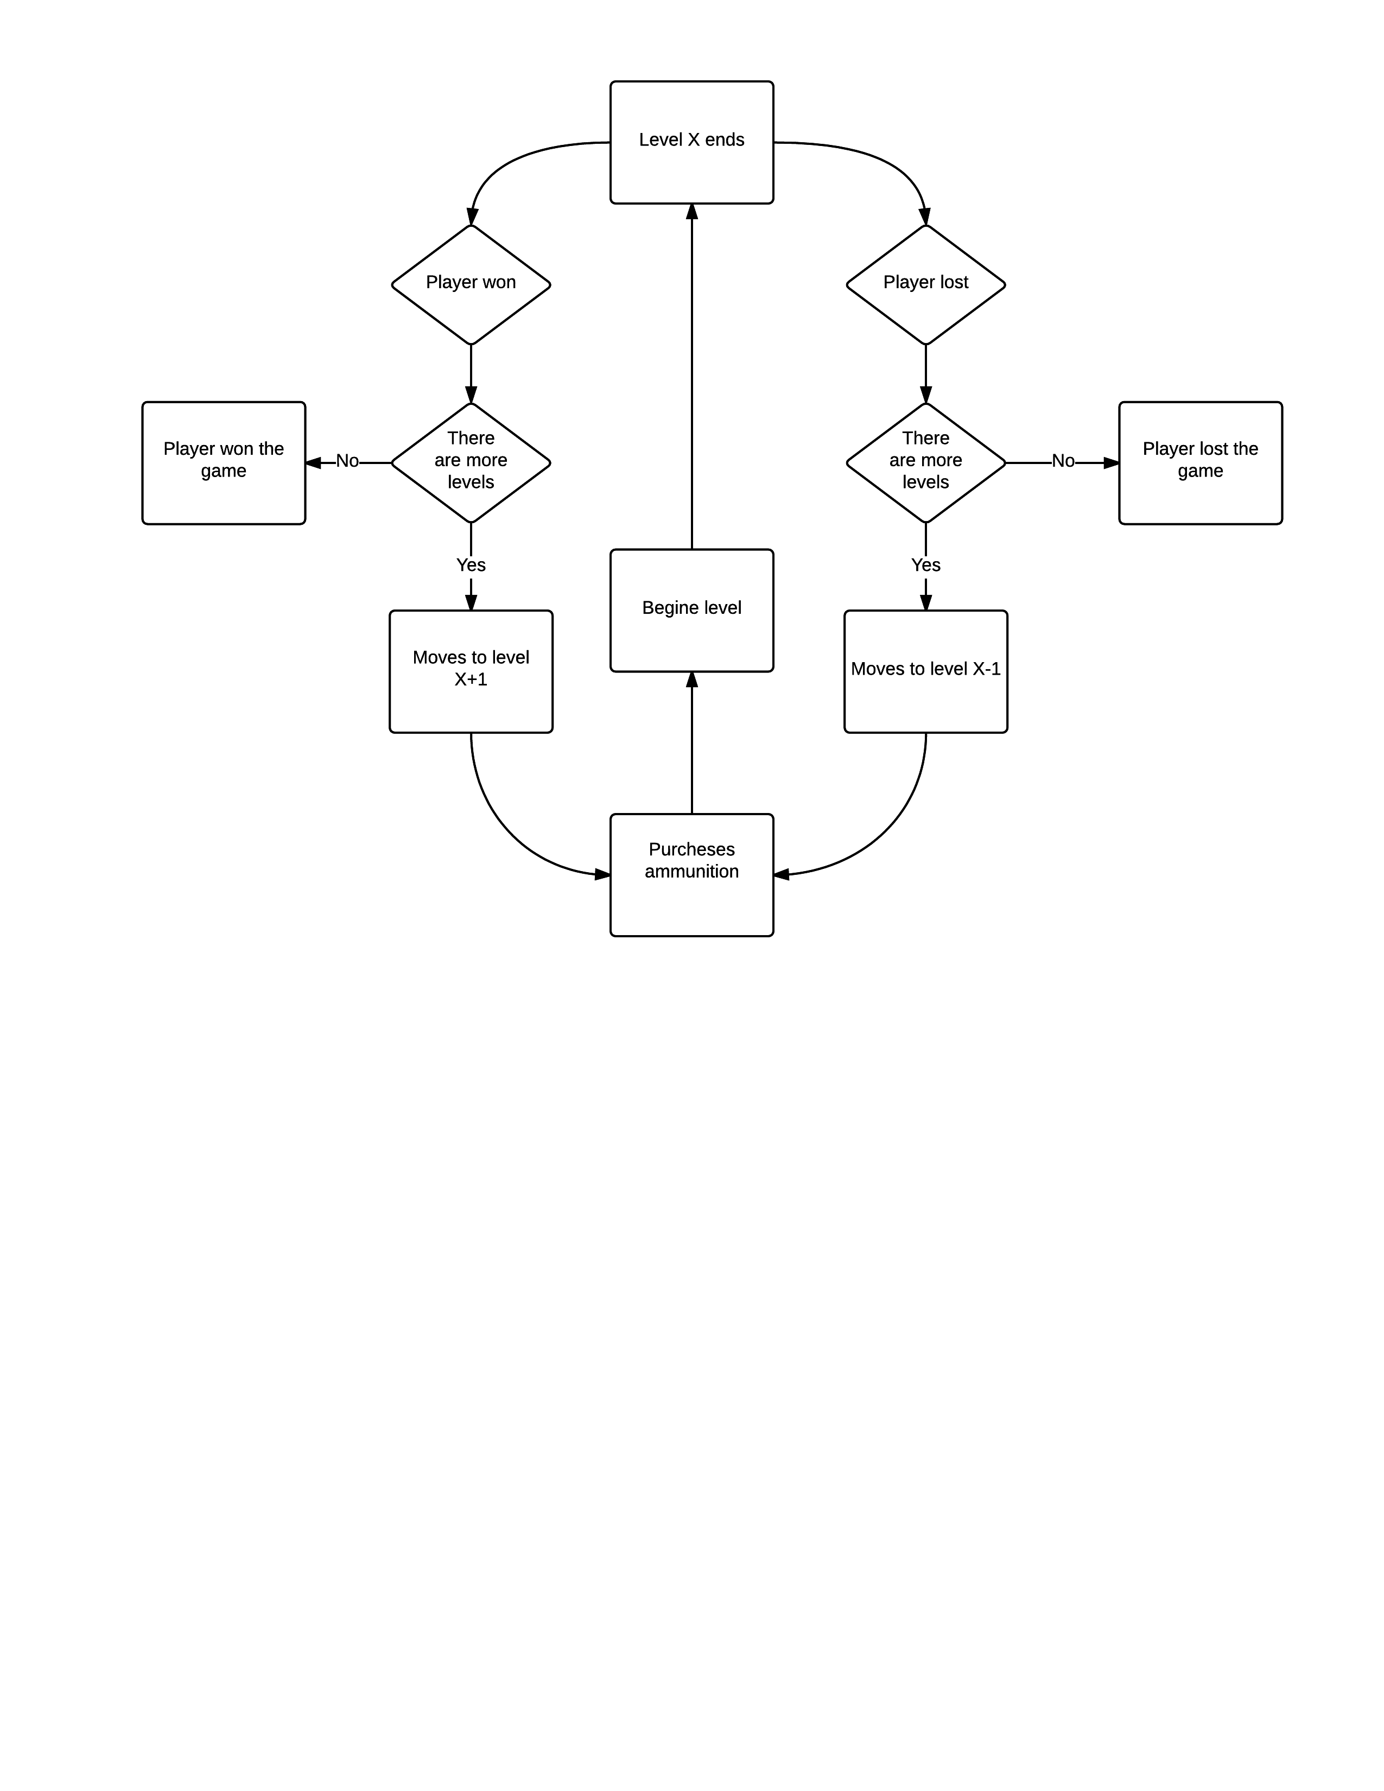
Game Levels Progression
Details

Slide 15
Game Level Progression Details
The game will have a "spectrum" of X numbers of levels depicting the tides of the war.
The player will start the game in level 0.5X.
If the player will lose, but not all of his tanks will be destroyed, he will start level (current level)-(one level). i.e., NATO was pushed further west.
If the player will win, he will start at level (current level) + (one level). i.e., the Soviets were pushed further east.
Upon winning level X, the player will win the game.
Upon loosing level 1, the player will lose the game.
If all the player's tanks were destroyed, he will lose the game.
At the end of each level player will receive score and requisition points according to the following criteria:
Number of Soviet tanks killed with artillery fire.
Number of American tanks survived.
Time elapsed from beginning of level.
Between levels, player will be able to buy reinforcement tanks and special ammunition for the next level.
Each level, the player will start with the same amount of tanks had had at the end of the previous level.
Tanks will earn experience points (XP) for enemies they killed. XP will improve tanks stats (Hit Points, rate of fire, accuracy, chance of critical hit, etc).
Every once in a while, play will receive reinforcement of fresh tanks.
Length of each level: ~5 min

Slide 16
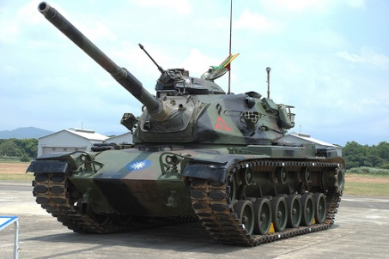
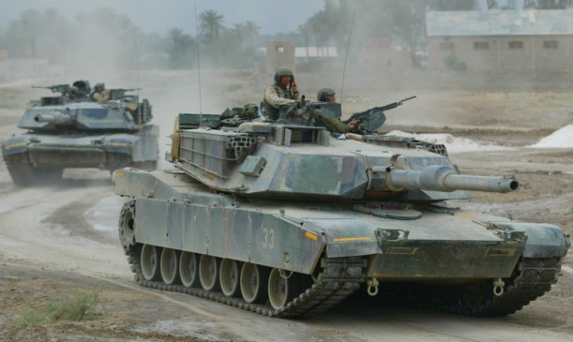
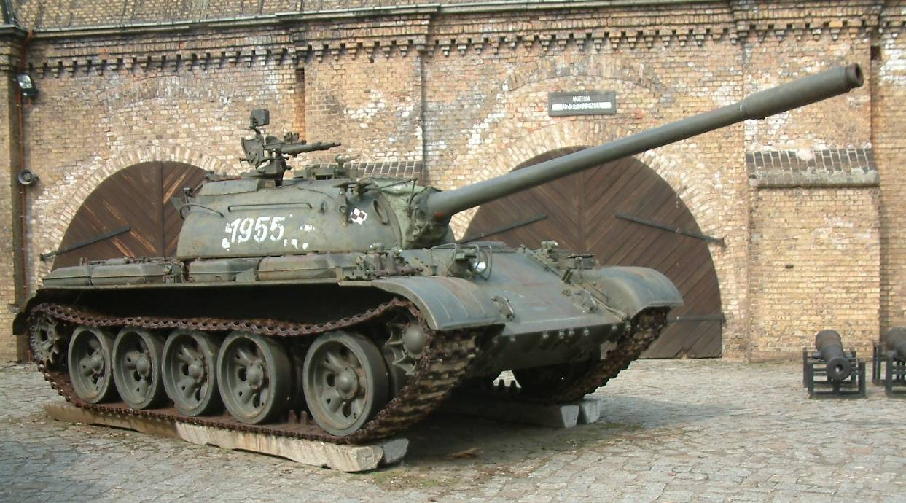
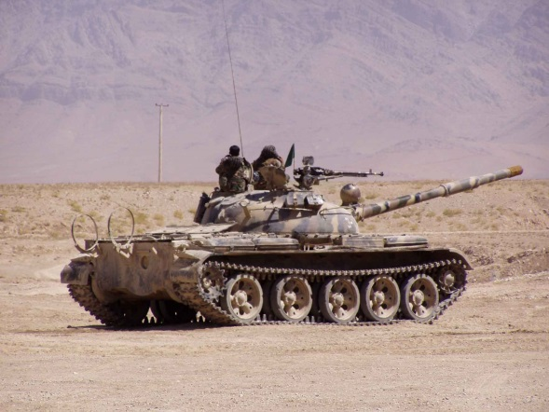
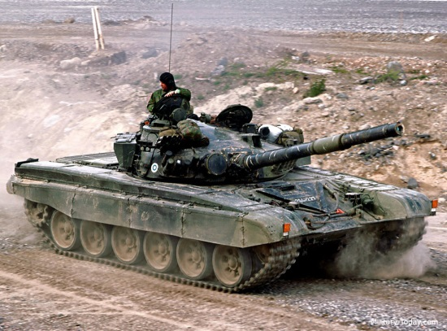
Game units
American Tanks:
M-60A3 Patton
M-1 Abrams
Soviet Tanks:
T-55
T-62
T-72

Slide 17
Unit Stats
Tank stats are as follows:
Armor: The amount of damage point reduced from each shell that hits the tank.
Hit points: The amount of damage each tank can withstand. When HP is reduced to 0, tank is destroyed.
Damage: The amount of HP that each shot reduces to the tank it hits.
Rate of Fire: The number of shots each tank can fire per minute.
Accuracy: The chance of each shot fired to hit the target (in percentages).
Speed: Speed of tank across even terrain.

Slide 18
Armor Points
Tank | Armor Points
M-60A3 | 10
M1 | 25
T-55 | 15
T-62 | 20
T-72 | 35

Slide 19
Hit Points
Tank | Hit Points
M-60A3 | 250
M1 | 600
T-55 | 100
T-62 | 300
T-72 | 600

Slide 20
Damage
Tank | Damage
M-60A3 | 30
M1 | 100
T-55 | 25
T-62 | 50
T-72 | 100

Slide 21
Rate of Fire
Tank | Rate of fire (shots per minute)
M-60A3 | 3
M1 | 5
T-55 | 3
T-62 | 2
T-72 | 5

Slide 22
Accuracy
Tank | Accuracy
M-60A3 | 70%
M1 | 90%
T-55 | 65%
T-62 | 80%
T-72 | 90%

Slide 23
Speed
Tank | Speed (Meters/Second)
M-60A3 | 80
M1 | 75
T-55 | 90
T-62 | 80
T-72 | 65

Slide 24
Monetization
Game will be free to play.
Game will have 2 types of currency:
Requisition point: In game currency. Will be given for killing Soviet tanks and completing achievements.
Virtual currency: will be bought with money.
Player will be able to buy all the munitions with virtual currency and in-game currency.
Player will be able to buy reinforcement tanks with virtual currency and in-game currency.
(Optional) Player will be able to unlock further expansions/episodes (i.e. World War II scenarios, futuristic imaginary scenarios, etc.) with virtual currency and in-game currency.

Slide 25
GUI:
The game will contain the following GUI:
Requisition Points (Below score, numerical)
HP bar - will indicate severity of damage done to the tank (above each American tank, bar).
Munition types - will indicate amount of the different types of munitions available t the player remaining (top of the screen, numerical + munition icon).
Control Score bar – will indicate the amount of Control Score both parties have, in relation to the goal and to each other (top-middle screen, bar).

Slide 26
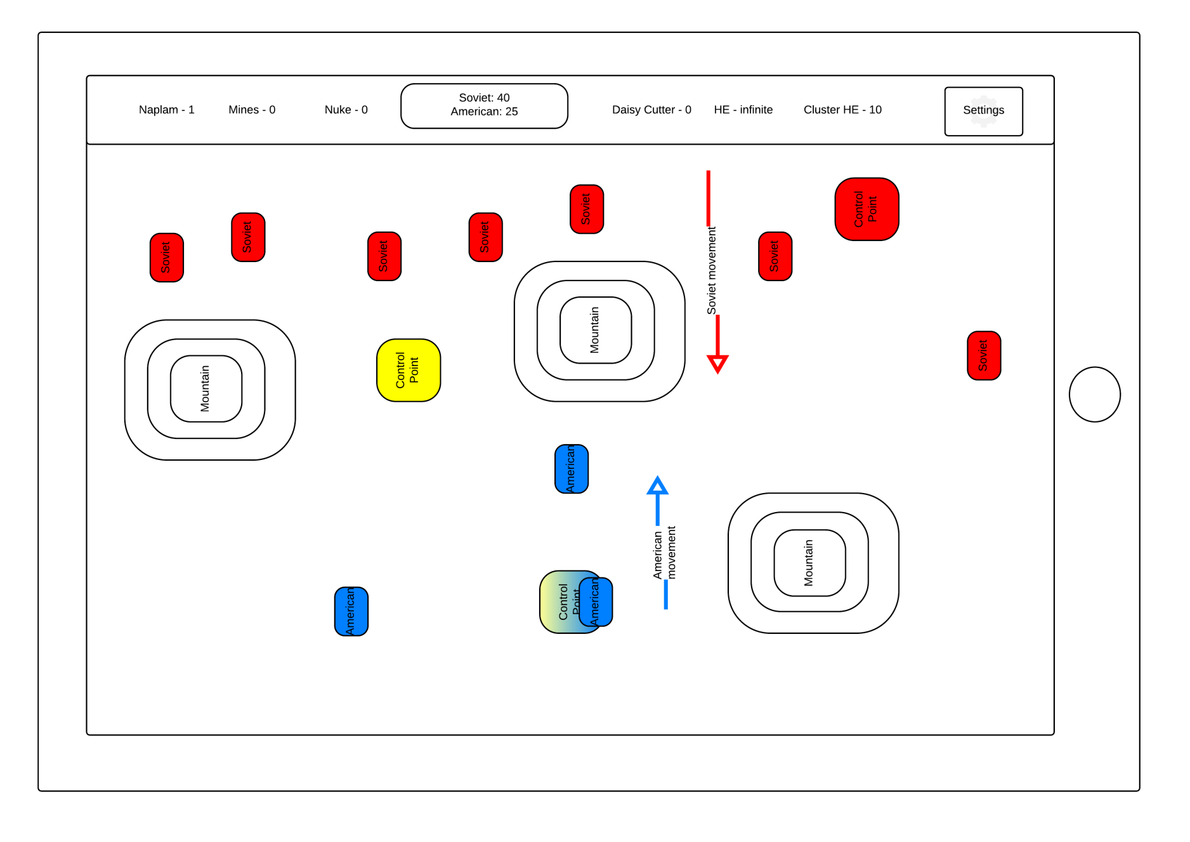
General Wireframe

Slide 27
Visual
The game will be 3D Top-orthographic view, with limited camera control (limited zoom, pan and roam).
The game will portray the tanks in a distinct manner (player will be able to differentiate between the different tanks in the game), using 3D models (probably bought from asset stores).
Levels will try to depict the terrain of Fulda gap and stay authentic to the terrain and foliage of western Germany.

Slide 28
Tools
Game Engine: Unreal Engine 4
Other production tools: Photoshop, 3DS Max, Unreal/Unity asset stores.

Slide 29
Files
Preliminary Game Statistics
Concept Paper

